Slide 1

My farm
Caption
Team 3 - project 3
Powered by SegesCoin (SCN)
By Alex, Brendan, Deep, Elias. Phillip & Pablo

Slide 2
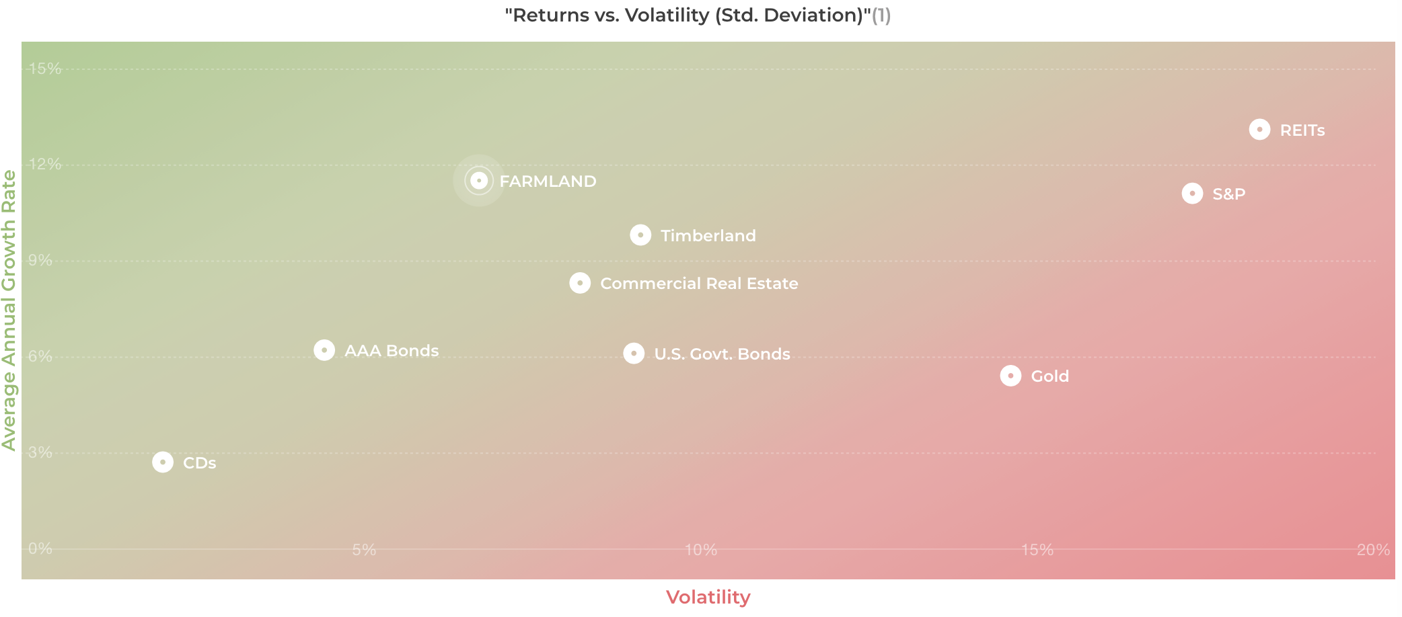
Land is one of the oldest investment classes, producing enormous wealth over generations
Land investing builds equity, preserves capital, hedge against inflation

Slide 3
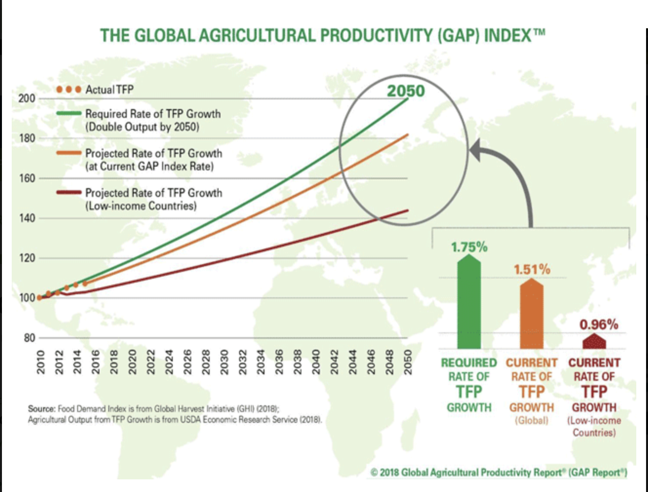
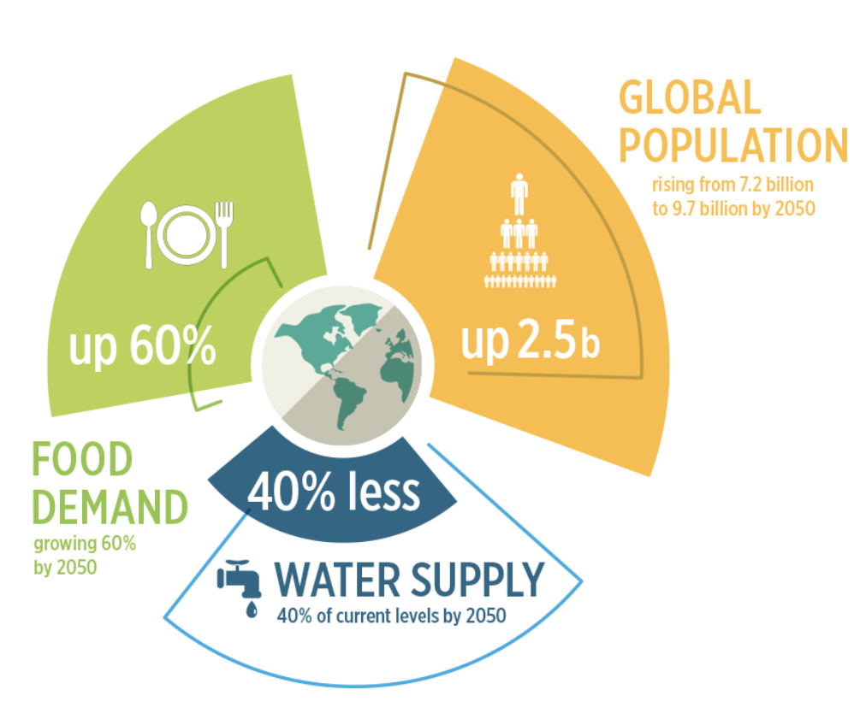
Global demand for food will continue to grow
Food demand is expected to grow anywhere between 53% to 98% by 2050
Caption

Slide 4
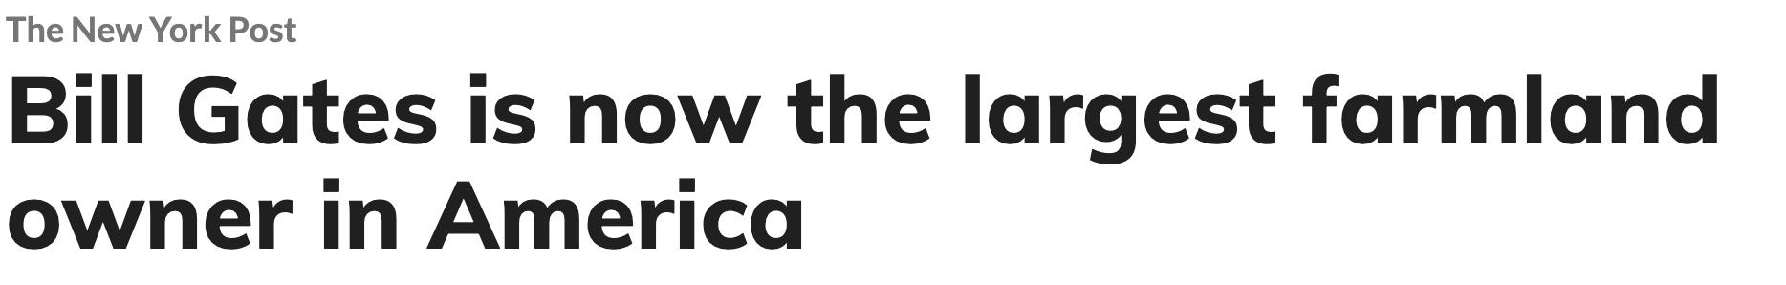
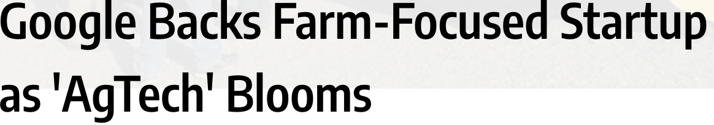
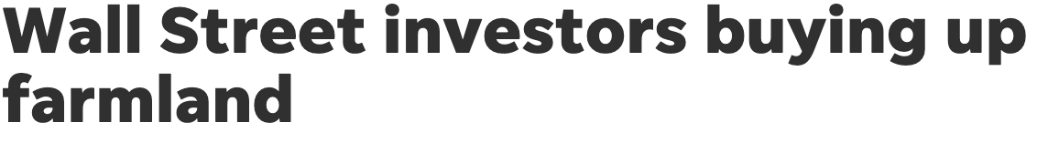
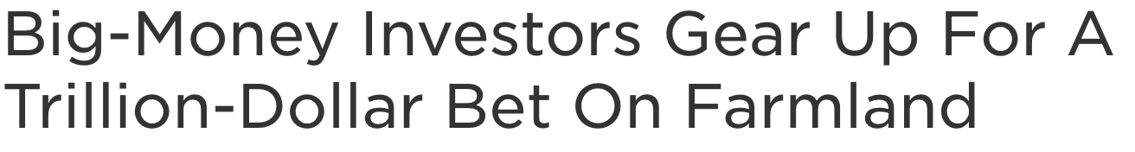
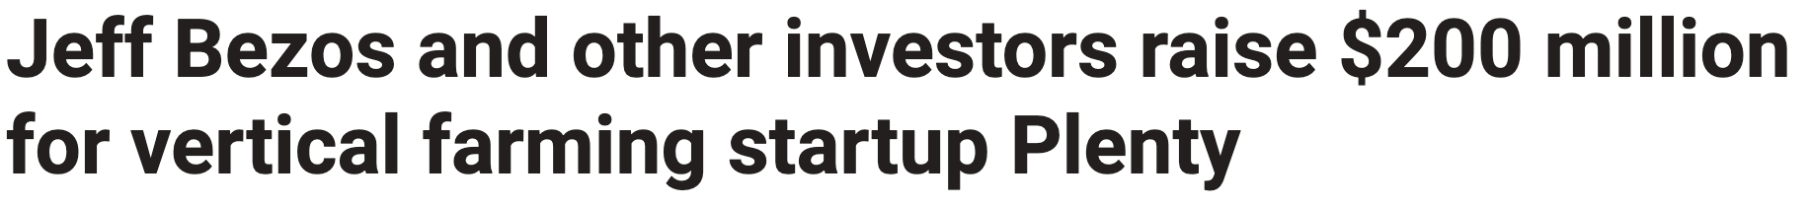
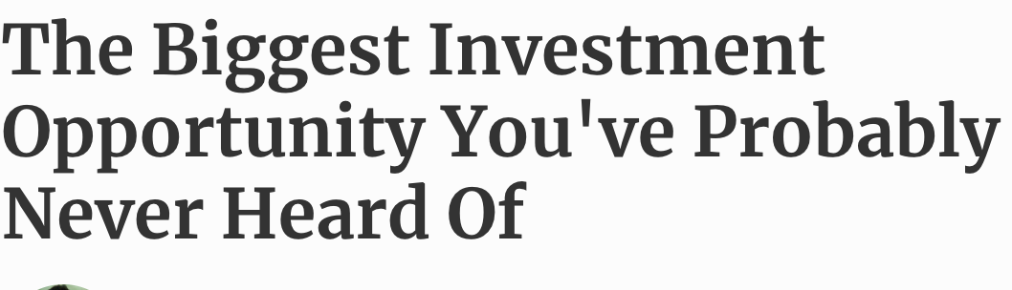
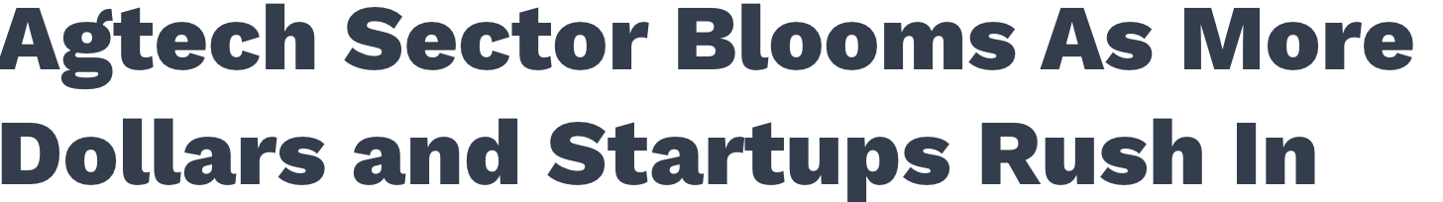
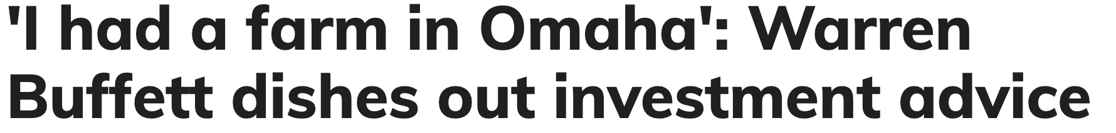
Invest where the ultra high net worth do
Investing in farmland made easy and accessible using blockchain technology
Caption

Slide 5
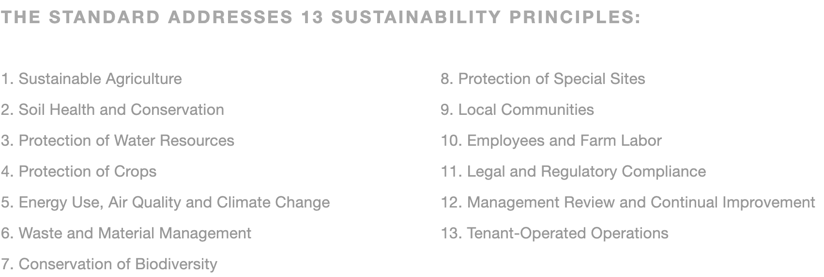
Invest where your values are
Environmentally and socially responsible investing
Strict sustainable agricultural standards to help the environment
Focus on small and family owned farms have a positive social impact
LeadingHarvest.org
Caption

Slide 6

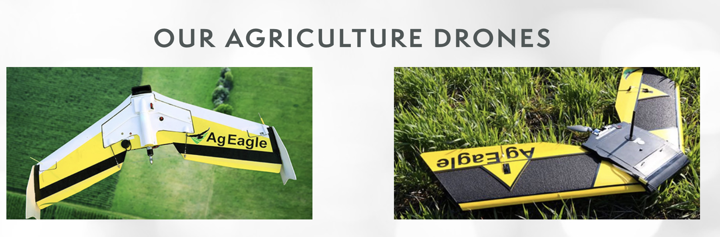
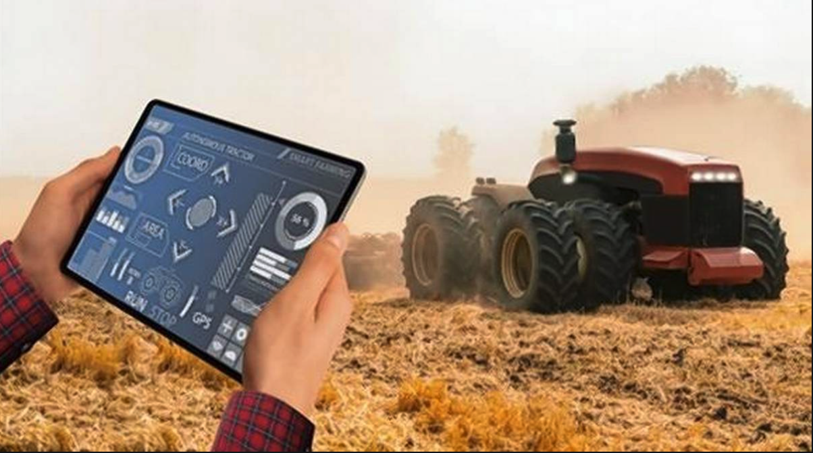
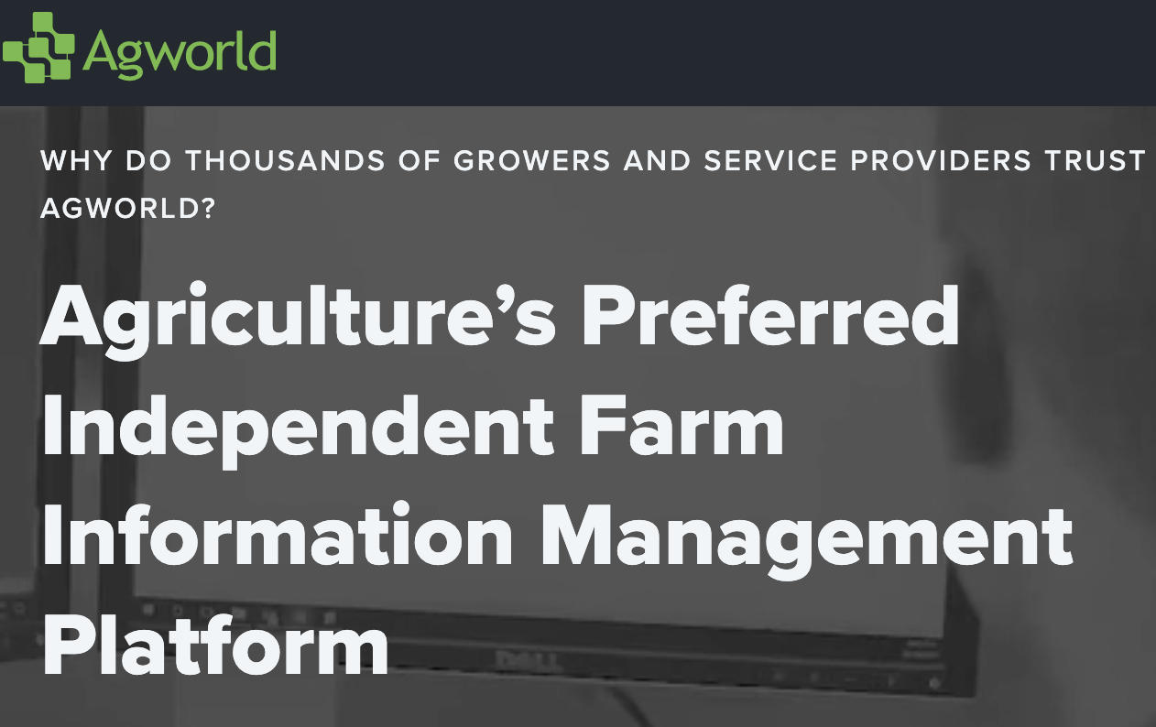
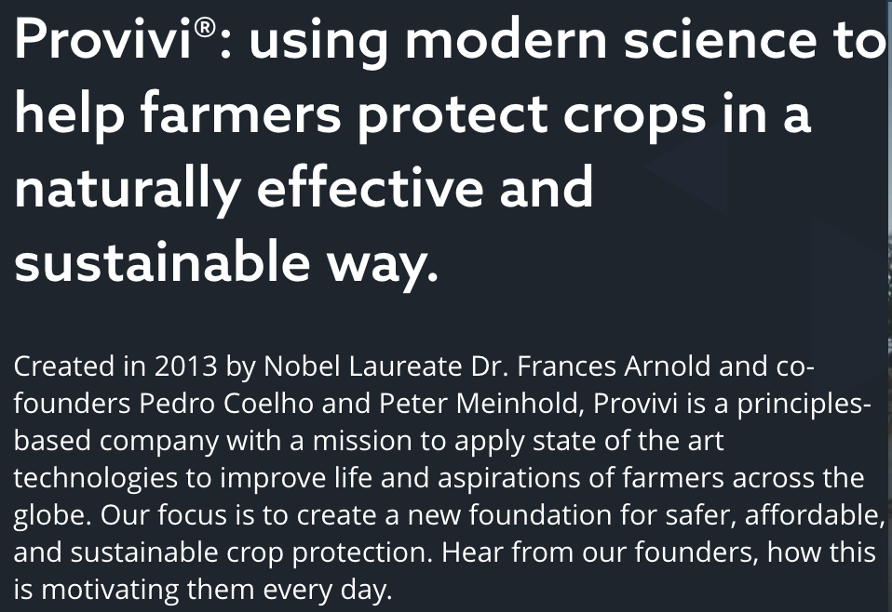
Using the latest agro tech to manage and upgrade our farms
The future of agriculture
Caption

Slide 7
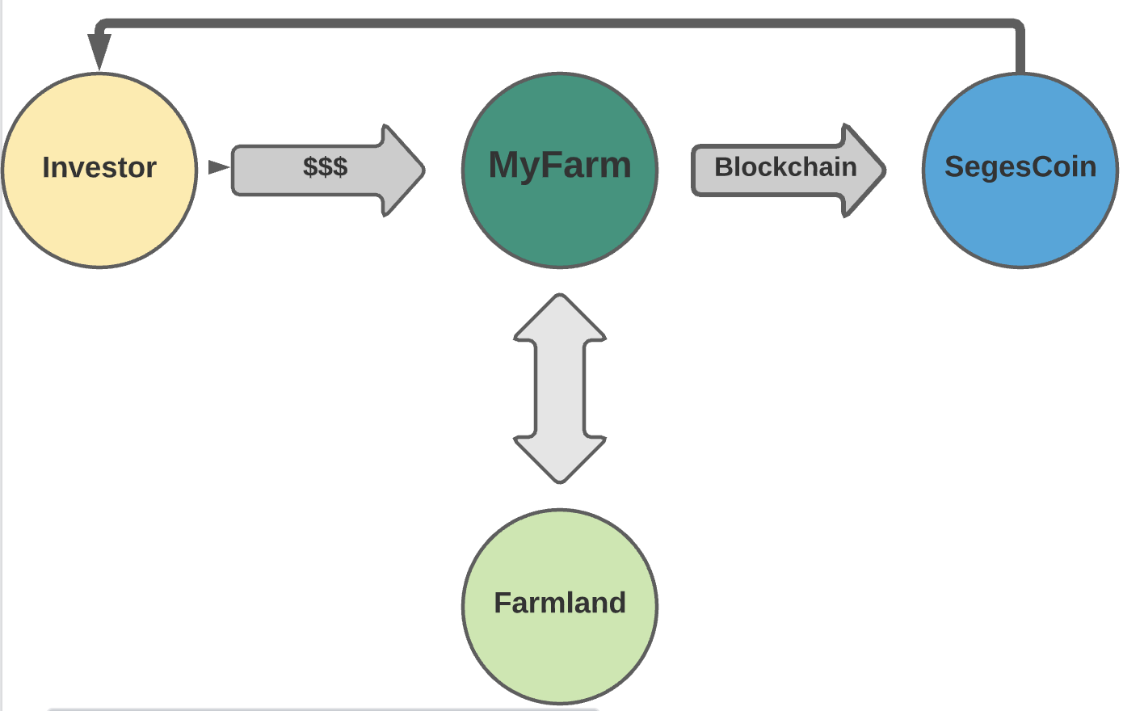
Tokenizing your farm
How it works
Caption

Slide 8
YOU BUY A TOKEN FROM US WE TAKE CARE OF THE REST
HOW IT WORKS
Initial crowdfunding aim to raise $20mm
Min initial investment $5,000
Max initial investment $25,000
2 yr limit to acquire land or your money back
We’ll aim to list SgesCoin in as many exchanges as possible
Caption

Slide 9
FARMLAND ACQUISITION Parameters
How it works
Option 1 - Buy and lease back
Option 2 - Partial ownership subject to production standards
Small Plots - 2 to 25 acres
Closer to large urban centers
Geographically diversified
Agriculturally diversify
Caption

Slide 10
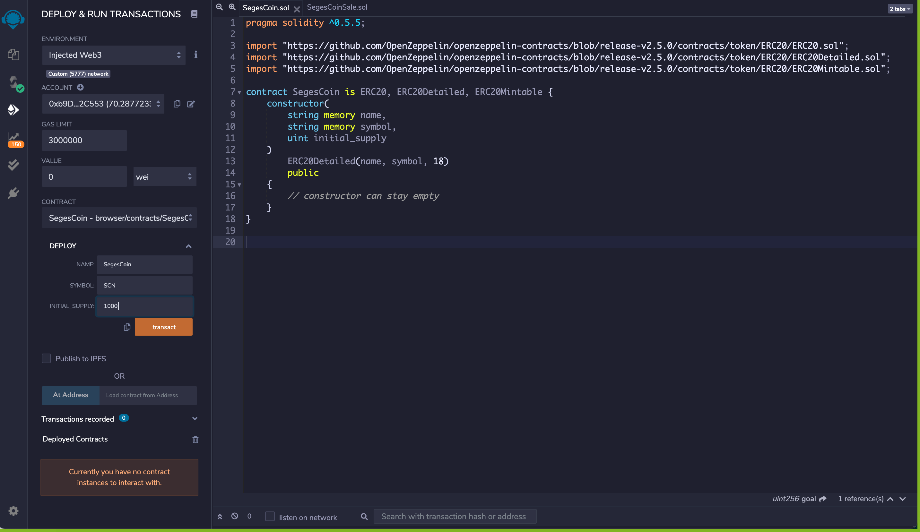
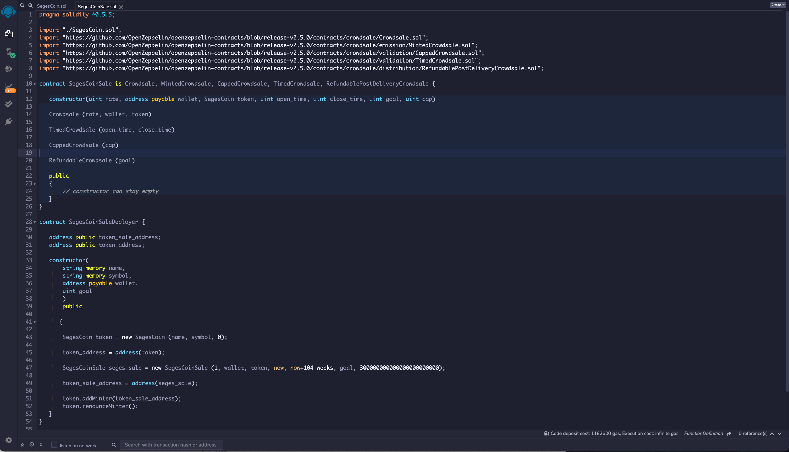
Smart contracts design in remix
Creating segescoin
Caption

Slide 11
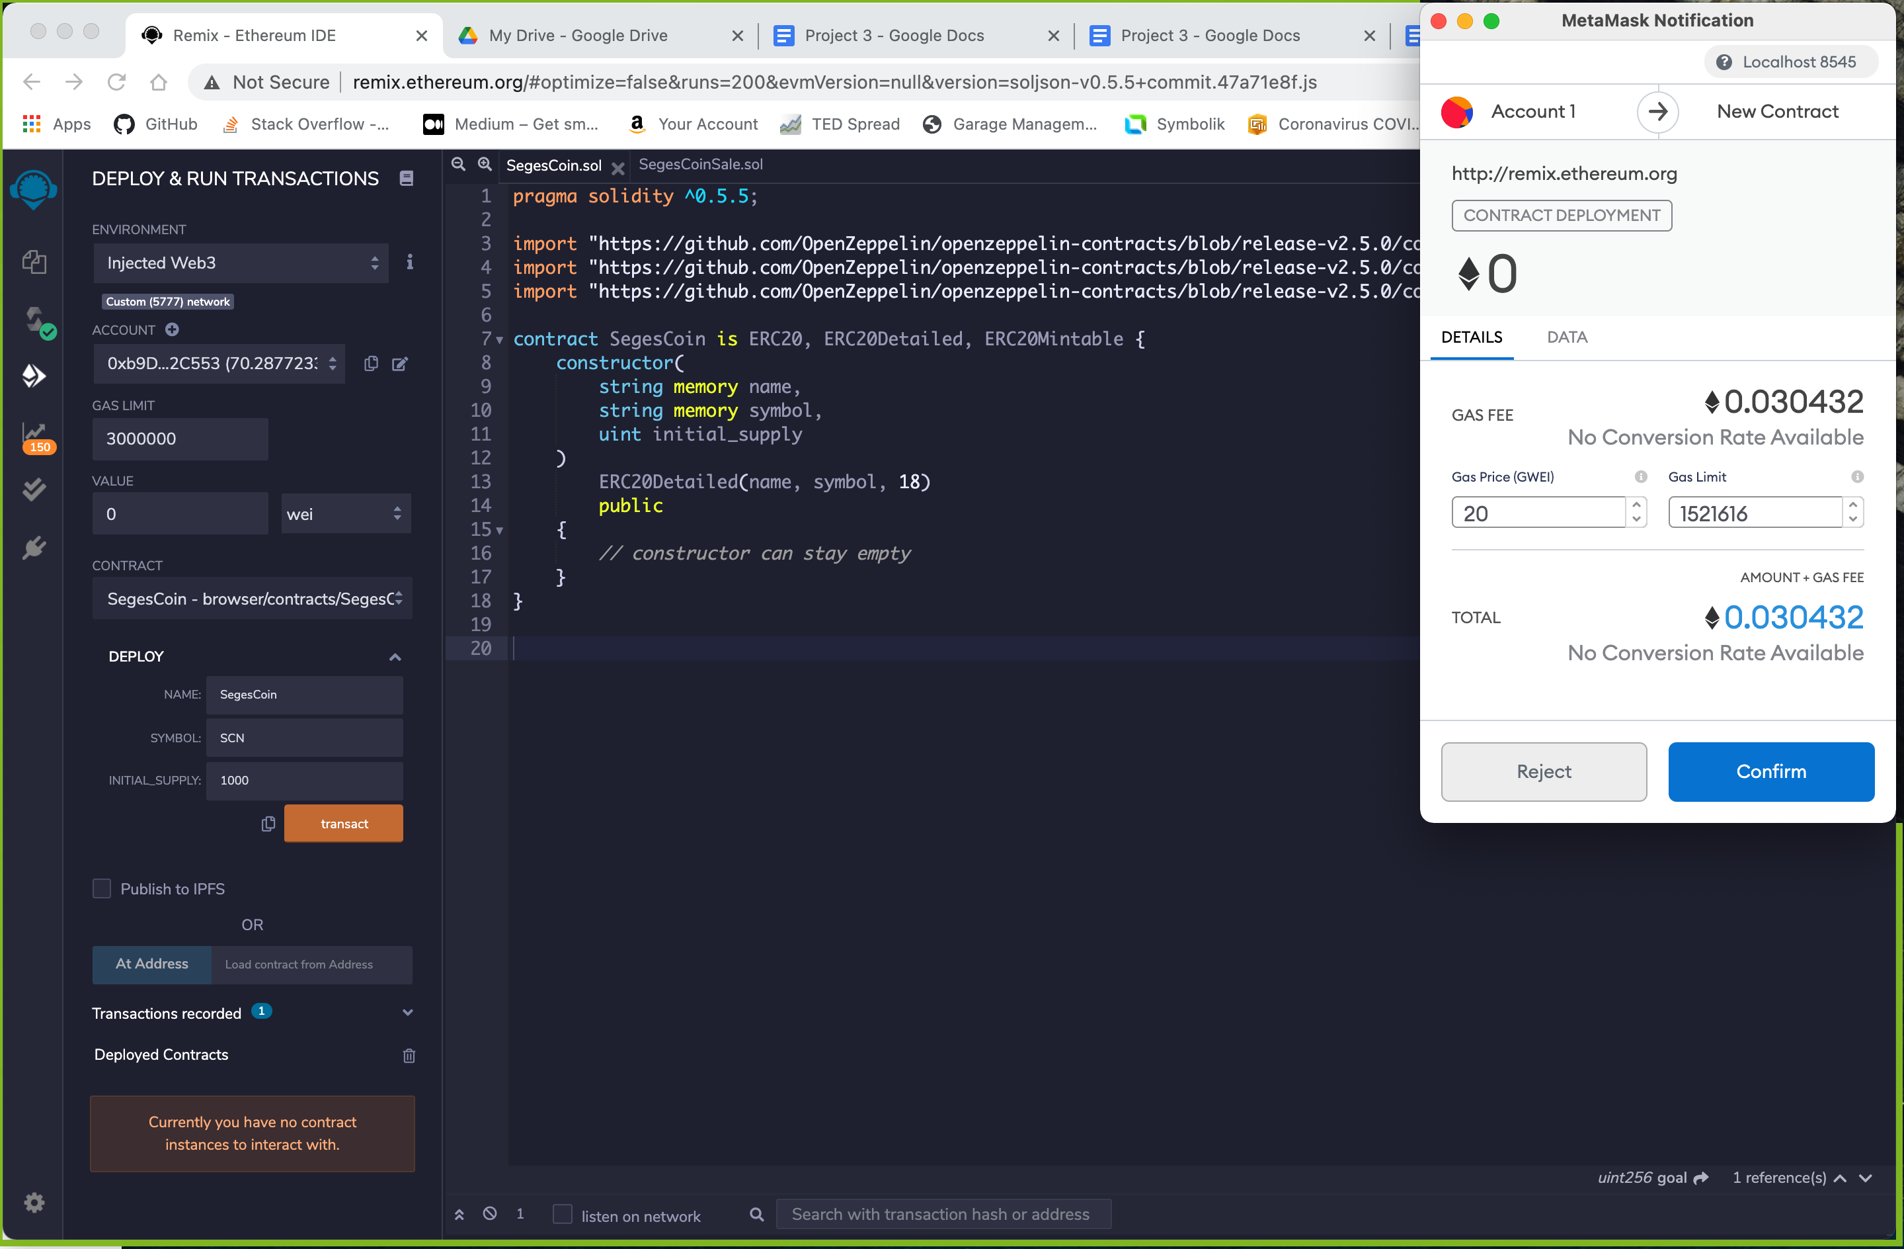
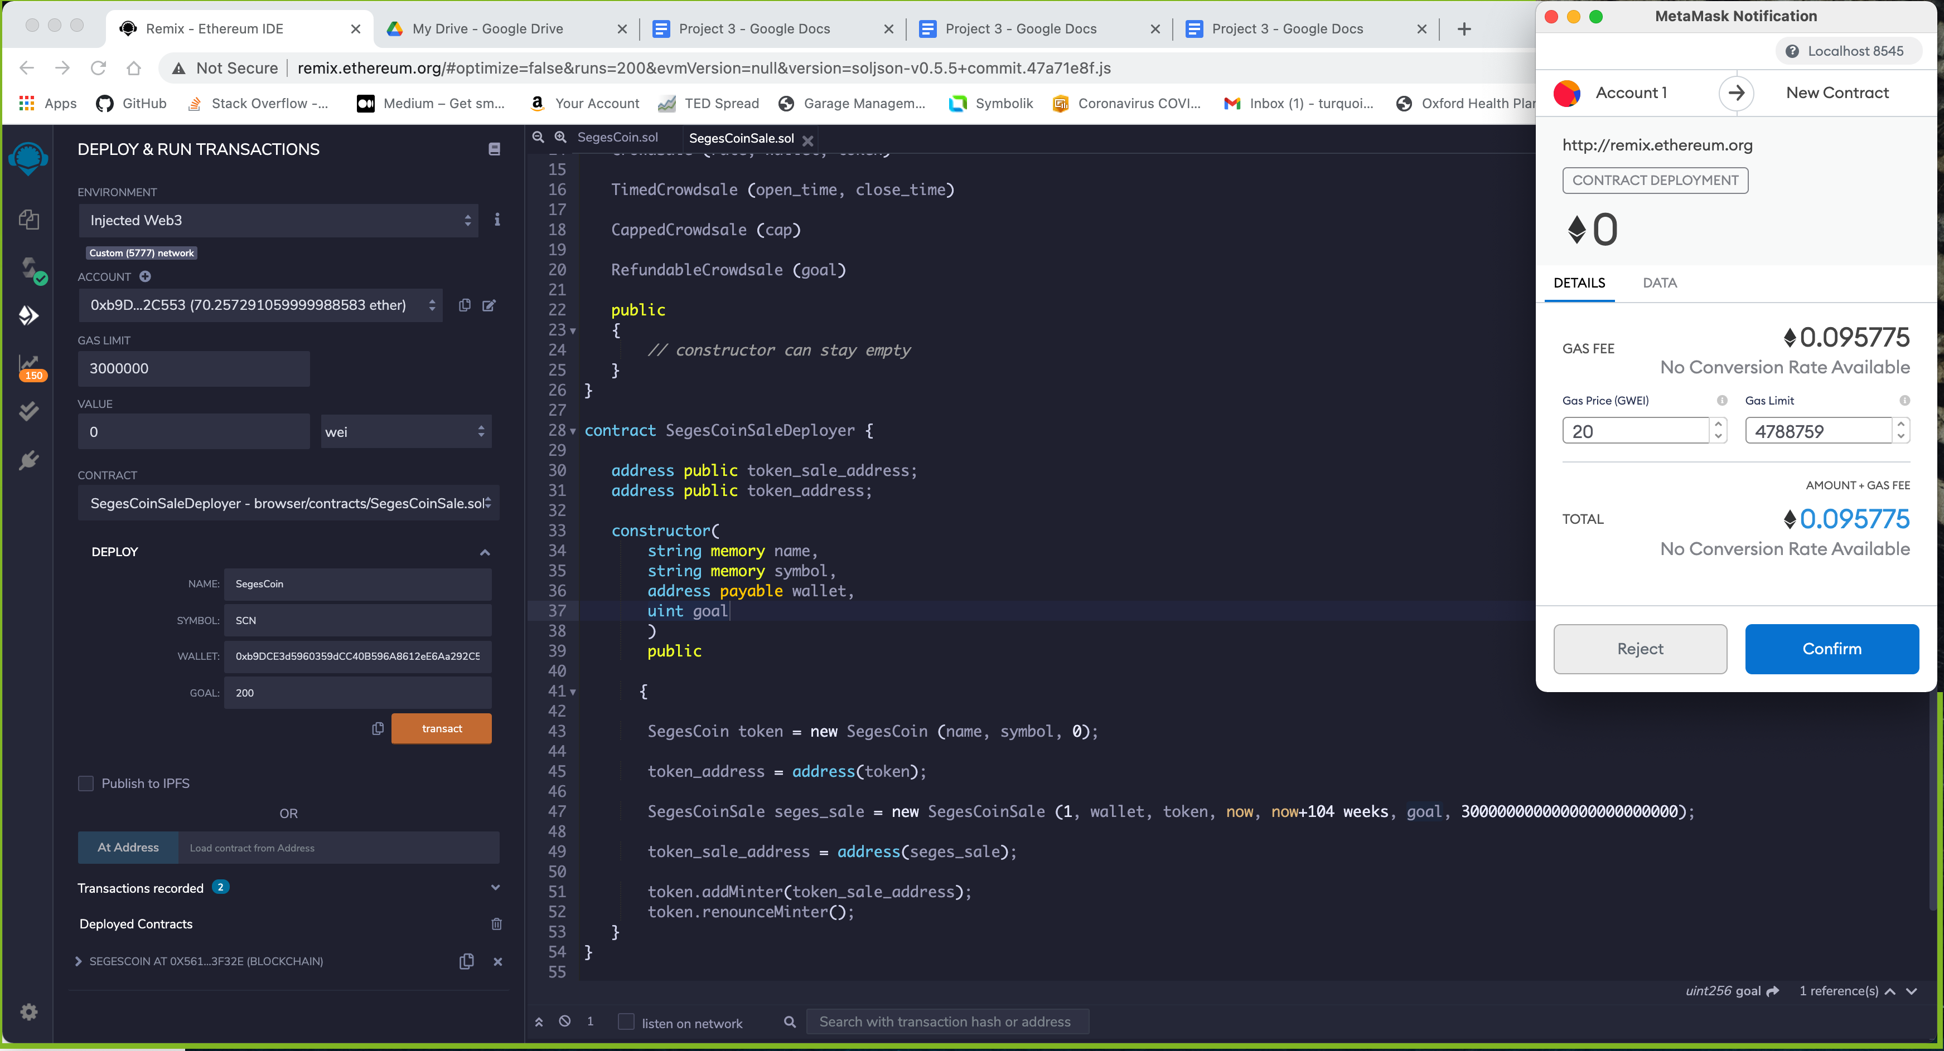
Deploying Smart contracts in remix
Creating sagescoin
Caption

Slide 12
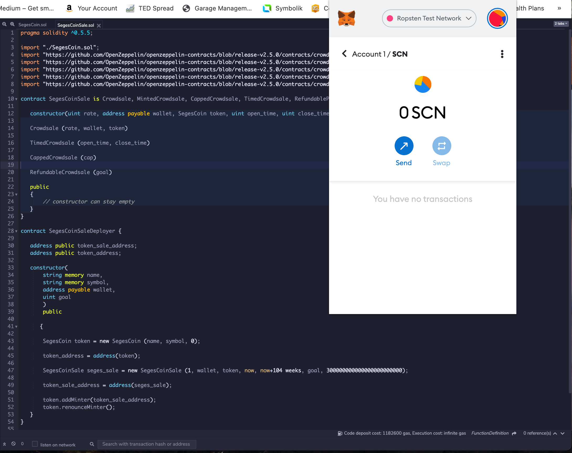
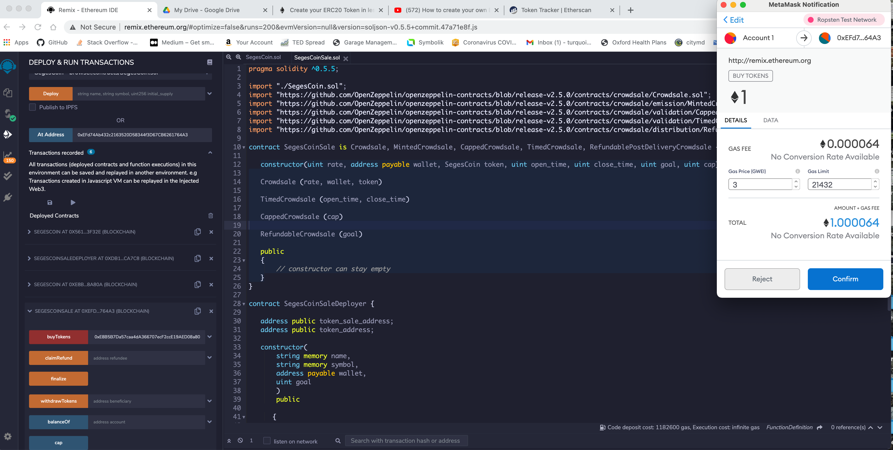
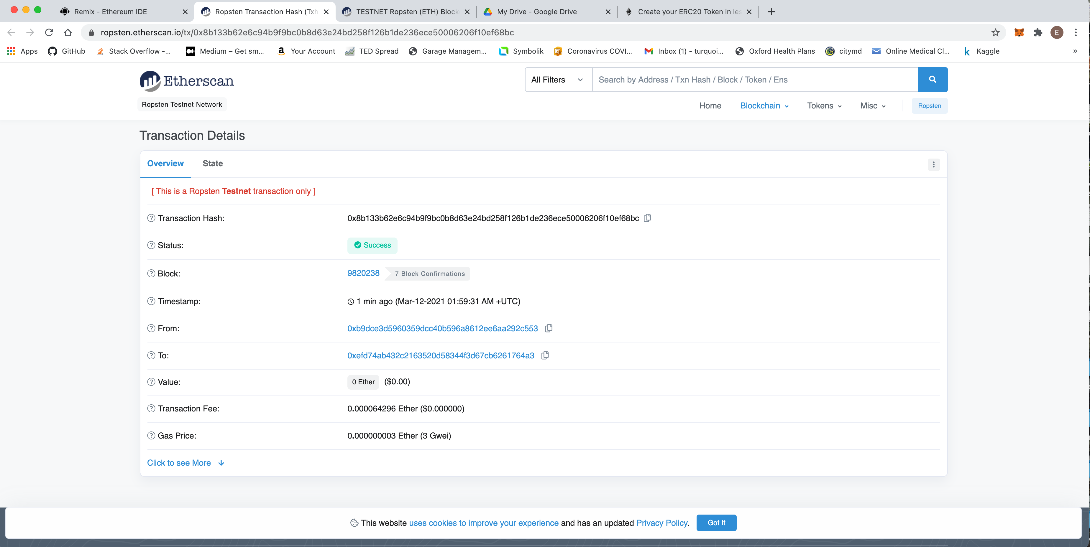
Testing smart contracts in the ropsten network
Creating segescoin
Caption

Slide 13
Land valuation
We use Machine learning to help us find and value farmland

Slide 14
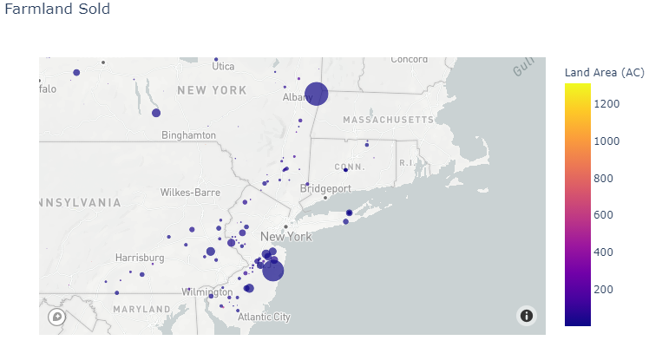
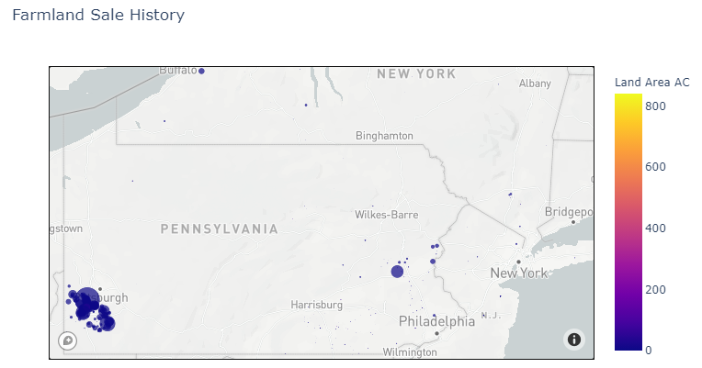
Scanning apis and plotting current farmland offerings

Slide 15
Are you ready to invest?
mYfarm - investment in farmland made easy
THANKS FOR LISTENING TO OUR PRESENTATION
ANY QUESTIONS?
Caption

Slide 16
WE’LL MISS YOU ALL!!!!
Caption

